Slide 1
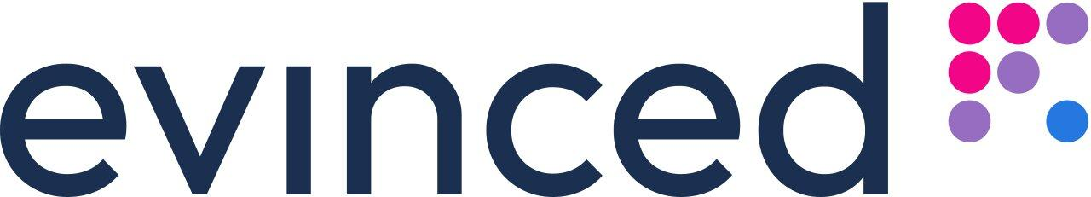

Let's create an Extension that Steals Everything!
January 2024 🎄🎗️
Asaf Shochet Avida
Notes:
Hi and welcome,
I want to thank…. For having me.
Today we are going to dive into the world of Chrome extensions,
Build an extension
See how can they be exploited
and what does the future hold for them
Feel free to ask anything, I will do my best to answer

Slide 2
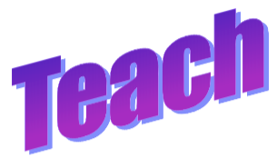
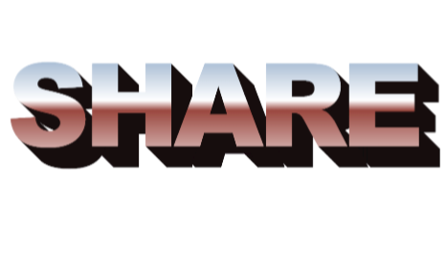
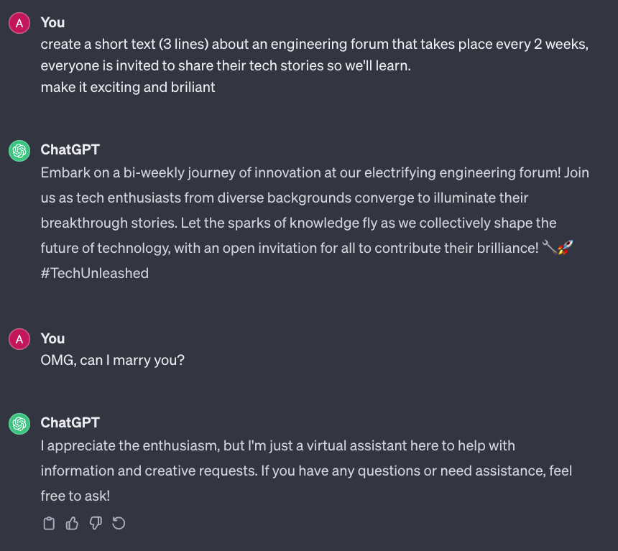
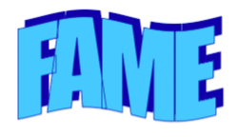
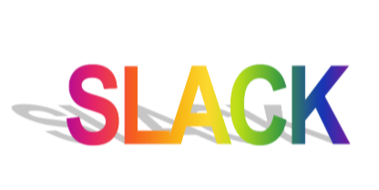
Notes:
The first time I had an accessibility task, a few years ago, it was a success on one hand, but a complete failure on the other hand. We had an application and we worked hard to make it accessible, applying many patches and specific a11y code into it, but everytime we had to change the appearance of the applications, things started to break. A lot like this:

Slide 3

Disclaimer
Notes:
למטרות לימודיות בלבד
אני לא עושה את זה
החברה שאני עובד בה לא עושה את הדברים האלה
אבל אנשים אחרים כן

Slide 4
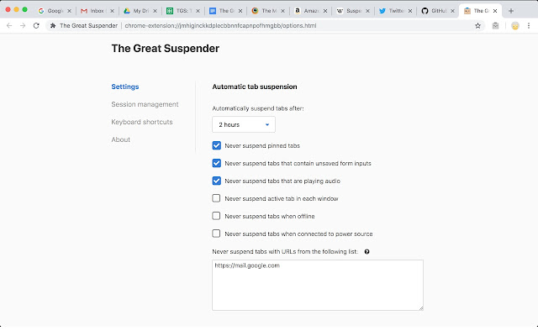
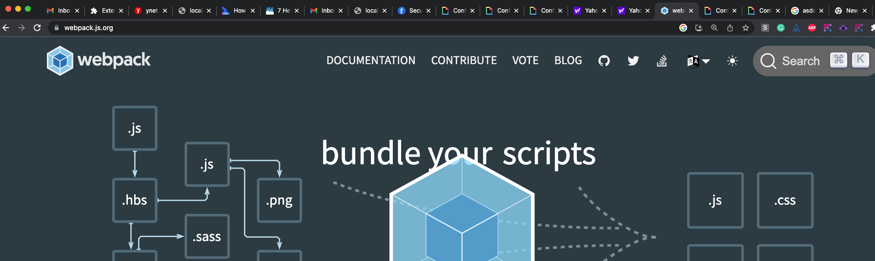
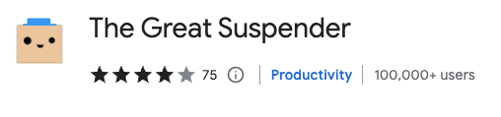
Story time
Notes:
Let’s start with a story
Imaging you are a web developer, or someone else working on a day to day basis with their computer
And the browser is getting heavier, slower. Hard to use. So you hear about an extension called the Great Suspender which shuts down unused tabs
And it works! So you tell your friends, and they are installing it – all 100,000+ of them.
And one day you find that

Slide 5
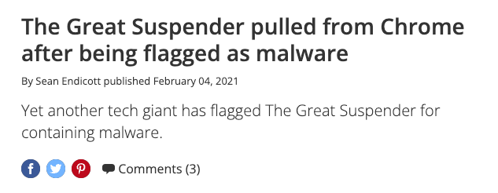
Notes:
It was malware, and you are infected.
Not by Phishing or by plugging a USB drive to your laptop while you’re at the pull.
By an extensions that did something good, and you installed it.
So how does it happen? That’s what we are going to break down today

Slide 6
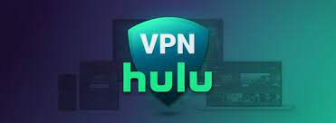



What is a chrome extension?
Extensions are software programs, built on web technologies (such as HTML, CSS, and JavaScript) that enable users to customize the Chrome browsing experience.
https://developer.chrome.com/docs/extensions/
Notes:
I guess you have some kind of extension installed on your machine, do you want to share?

Slide 7
Chrome Extension Components
Manifest (metadata)
Content Script (js)
Runs on the page itself
Background Script (js)
Runs on the background, persistent*, no UI
Responds to browser events
Popup (HTML + js)
Opens from the toolbar
Notes:
A note about frameworks

Slide 8

This is Guardian Angle ᵀᴹ
Community driven website protection.
Report hurtful content.
Support your community.
Photo: https://labs.openai.com/s/y341cFvw7Ccw8GFqQpquwcN3
Notes:
We have all that we need, let’s dive into the code

Slide 9
Coding time

Slide 10
Permissions (More)
Access DOM
Use XHR (talk to servers)
Run scripts
Download Scripts
Manipulate Network
Bypass CORS
Listen to browser event

Slide 11
Manifest V3 to the rescue
Security
No external code
Performance
Background to Service Worker
Privacy

Slide 12
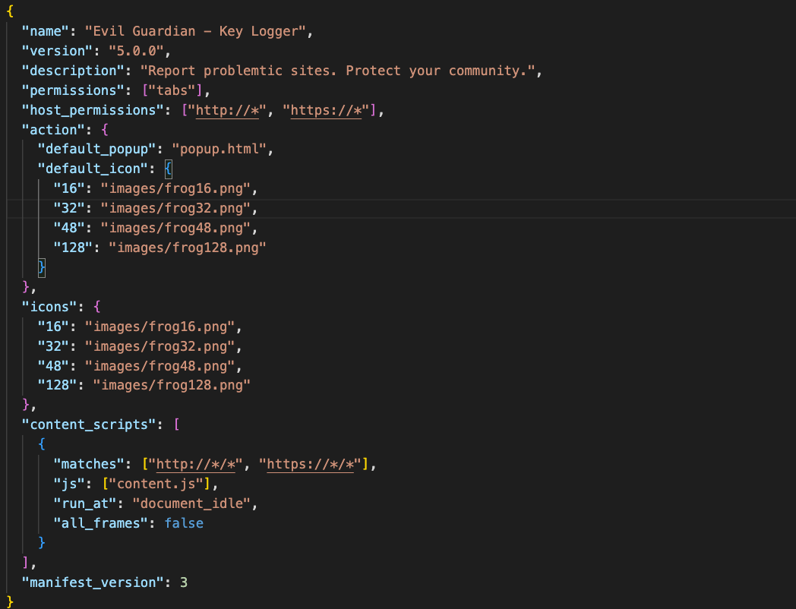

Slide 13
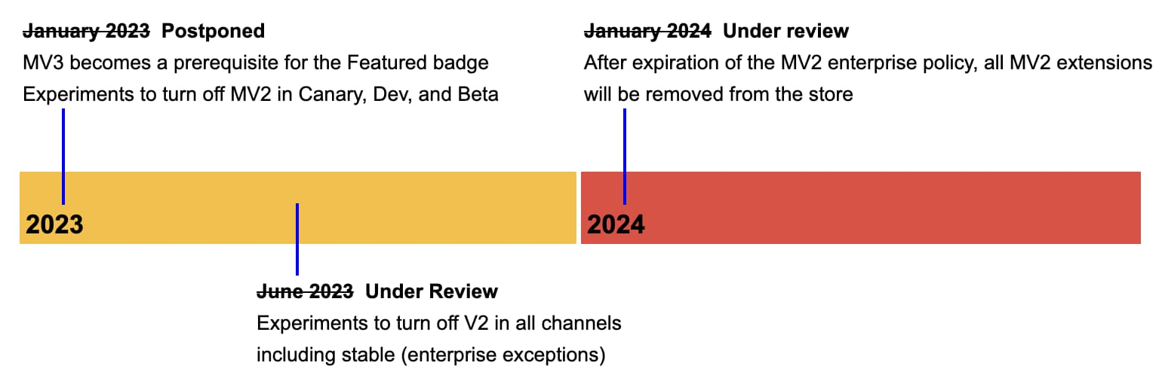
Moving to Manifest V3

Slide 14
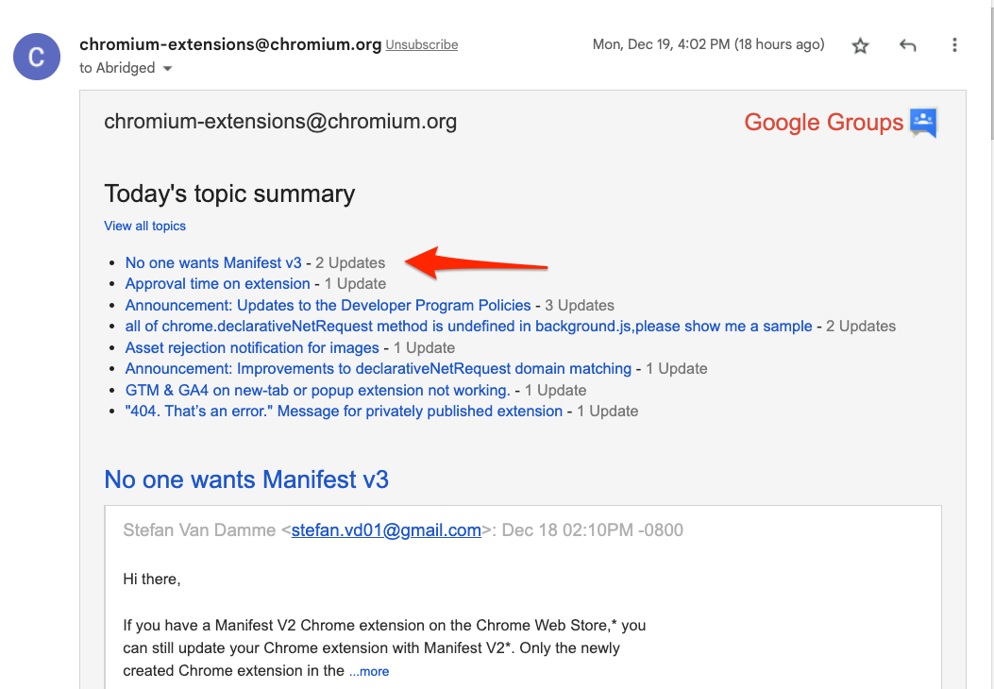

Slide 15
What did we do today?
Intro to Chrome Extensions
Built a do-good extension
Turned it into a do-bad extension
User tracker
Key logger
Steal sessions
Remote code execution
Manifest Version 3 to the rescue

Slide 16
Takeaways
1
2
3
Mv3 is Coming
Powerful
With Great Power..
Notes:
There are over 180,000 chrome extensions
Who is responsible for protecting the users
Should a website protect itself from the browser
Who is under attack, and can this be a different vector of attack, maybe take advantage of a logged in user and get privileges
Chrome extensions have been with us for at least 12 years, How is this the status for so long?

Slide 17
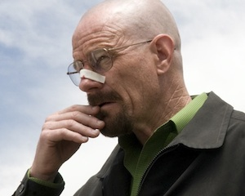
One final thought
Notes:
There are over 180,000 chrome extensions
Who is responsible for protecting the users
Should a website protect itself from the browser
Who is under attack, and can this be a different vector of attack, maybe take advantage of a logged in user and get privileges
Chrome extensions have been with us for at least 12 years, How is this the status for so long?

Slide 18


Thanks for listening
Asaf Shochet Avida
asaf-shochet
frogrammer.net
We’re hiring!
Notes:
So, as we said, I’m Asaf, I work for Evinced, we’re hiring for various roles ☺
It was a pleasure talking here today, You're welcomed to reach me on LinkedIn,
I'll see you in the Q&A session in a few minutes. And if you hesitate, remember that Accessibility is more accessible than you think.

